Slide 1
SUCCESS STORY

Slide 2
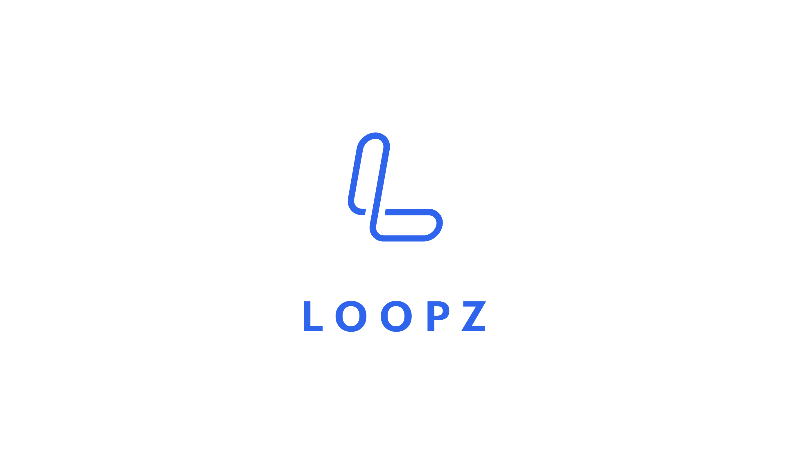
CASE STUDY
CHALLENGE
SOLUTION
Loopz.io is a company providing the mobile payments and plastic gift cards solutions for businesses or events.
Loopz.io team was challenged with the Java and .NET integration when working on the card printing Java based automate workflow system for processing new customers.
The .NET SDK printer needed to be fully controlled from Java application as if it was used natively from .NET.
The requirement was to achieve a safe, reliable and quick communication between the Java and .NET that would not be subjected to any type of interruption or unexpected malfunctioning.
It was crucial that the integration development does not consume excessive amount of time and resources.
The full control of the C# based SDK Fargo HDP 5000 plastic cards printer and the use of all of it’s features from Java application was possible with Javonet native integration solution.
Loopz.io development team after the unsuccessful evaluation of alternative solutions has quickly identified the advantage of Javonet.
Our native integration component allowed Loopz.io team to save over 4 months of the development. The important factors were the flat learning curve of the product and accessible broad documentation.
Javonet allowed for seamless communication between the .NET SDK printer and the Java application.
Find out how Loopz.io controls .NET driver Fargo plastic cards printer from Java application.
javonet.com

Slide 3
CASE STUDY
Javonet is the leading native integration technology between .NET and Java
Find out how Loopz.io controls .NET driver Fargo plastic cards printer from Java application.
“Javonet was easy to setup, well documented and saved us a lot of development time.”
~ Michael Elias – Loopz Founder
javonet.com

Slide 4
CASE STUDY
Javonet is probably the best Java to .NET bridge.
Find out how Loopz.io controls .NET driver Fargo plastic cards printer from Java application.
Javonet is the lightest and the simplest Java and .NET native integration framework. It allows to load and use any .NET DLL from Java code - within the same process and with extremely high performance.
The tool can be used in countless scenarios, saving time, effort and costs required to quickly re-use or share the .NET logic with Java. See the sample scenarios below:
Access any custom .NET library from Java
Use third-party .NET back-end components in Java
Access mathematical, statistical and financial algorithms
Control any physical devices with .NET SDK or driver from Java
Embed .NET UI controls in Java
Use .NET DLLs in Java applets
Access any C++/COM objects from Java
Use .NET UI frameworks like WPF or WinForms from Java
javonet.com

Slide 5
CASE STUDY
Start using .NET libraries in your Java projects today.
Find out how Loopz.io controls .NET driver Fargo plastic cards printer from Java application.
Javonet – Native Java to .NET Bridge
http://www.javonet.com
Quick Start Guide
https://www.javonet.com/quick-start-guide/
Download Java JAR
https://www.javonet.com/signup-for-trial/
Javonet Technical and Sales Support
Phone: +1 (415) 422-9377
Email: support@javonet.com
javonet.com

